Slide 1
HM R&C
Reform of the Construction Industry Scheme
Dennis Keeling
Business Application Software Developers’ Association

Slide 2
Agenda
9.30 Registration
10.00 Introductions Dennis Keeling, BASDA
10.10 Overview of HMRC reform of CIS Paul Martin, HMRC
10.40 Submitting the message Andy Greener, HMRC
11.10 Refreshment Break
11.25 Business System requirements Dennis Keeling, BASDA
11.45 Generating XML from your system Steve Baker, BASDA
12.30 Questions / Close

Slide 3

UK-based, not-for-profit, international representative body
200 members from SAP, Microsoft , Sage, etc.
Accounting, Human Resources, Logistics, Manufacturing, Taxation & Web-based applications
Established in 1993, significant growth in 2000
Elected General Council - Cross Industry
Recognised by
  OECD, UN, EU, FEE,
  UK - BoE, DTI, FSA, HM R&C, HM Treasury, OGC, OeE,

Slide 4
International Standards Body
BSI Accounting Kitemark
VAT Standard – 1995
  VAT Accreditations
EDI Standards – 1996
RFI Procurement Standard
EMU Standard – 1997
  EMU Accreditation – 40+ Packages
eBIS-XML Standard – 2000
  eBIS-XML Accreditation – 20 + Packages
Inland Revenue
  Self Assessment – 2000
  PAYE – 2001
  Corporation Tax – XBRL 2002
FSA – Regulation - XBRL
eCollaboration
  Stakeholder Pensions - 2000
  House Builders - 2001
  Local Government, Universities, Colleges
  Business & Office Stationery Suppliers
  OGC eProcurement – 2003-4
Accounting Standards
  IFRS White Paper - 2003
  OECD Audit File - 2004
  OECD Software Guidance – 2004
  US Sarbanes Oxley White Paper - 2005
Information
RFI White Paper
Upgrade Booklet
eBusiness Booklet

Slide 5
Regulation Calendar
2005
  IFRS – all public companies
  Payroll eFiling – XML (large organisations 250 employees)
  Corporation Tax CT 600 eFiling - XBRL
  Companies House Annual Accounts eFiling – XBRL
  eProcurement – all suppliers - XML
  NHS NPfIT – centralised Patient Records - XML
  VAT 100 / ESL / Intrastat eFiling - XML
  VAT Audit File for Tax purposes – SAF-T
  BACSTEL replacement by Dec 2005
2006
  FSA Regulatory eFiling of regulatory information – XBRL
  HM R&C CT Filing - Profit & Loss / Balance Sheet – XBRL
  HM R&C CIS Reform
  HM Treasury – VAT at place of Consumption
  IFRS Update – Sarbanes Oxley procedures incorporated
2009
  Payroll eFiling – XML – all companies.

Slide 6
Inland Revenue / HM Revenue & Customs
Self assessment – eFiling - 2000
PAYE – eFiling – 2001
Corporation tax – CT600 – 2003
Construction Industry Scheme – 2006
  Replace previous voucher system
  Monthly sub-contractor statements
  Monthly HMRC contractor payment return
  HMRC on-line validation / tax status

Slide 8
CIS Introduction
Not a simple upgrade of existing systems
More aligned to Accounts Payable than Payroll
Big-bang cut-over – April 2006
  No parallel running with existing voucher system
Major initial support issues
  Cut-over conflicts with PAYE year-end filing

Slide 9
Structure of messages
Uses established SA / PAYE eFiling mechanism
Incorporates IR-Mark
  SHA-1 Hash / Canonicalized XML
Uses standard XML with schema validation
3 XML messages
  CIS request
  CIS response
  CIS return

Slide 10
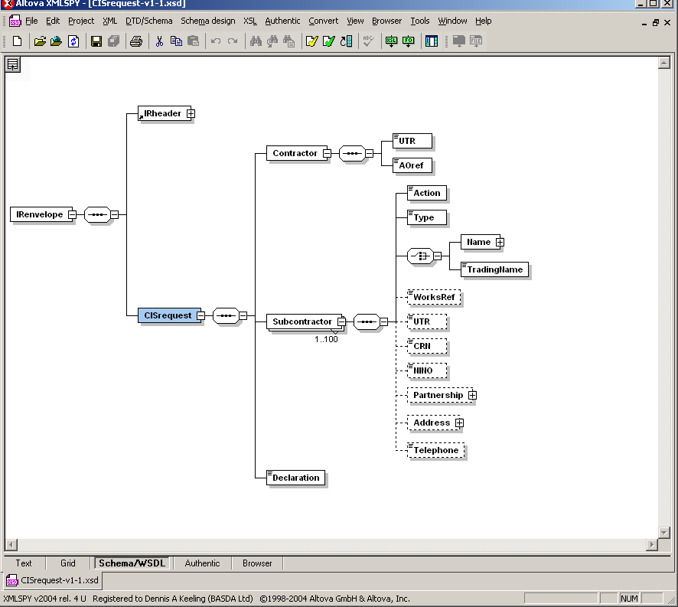

Slide 11
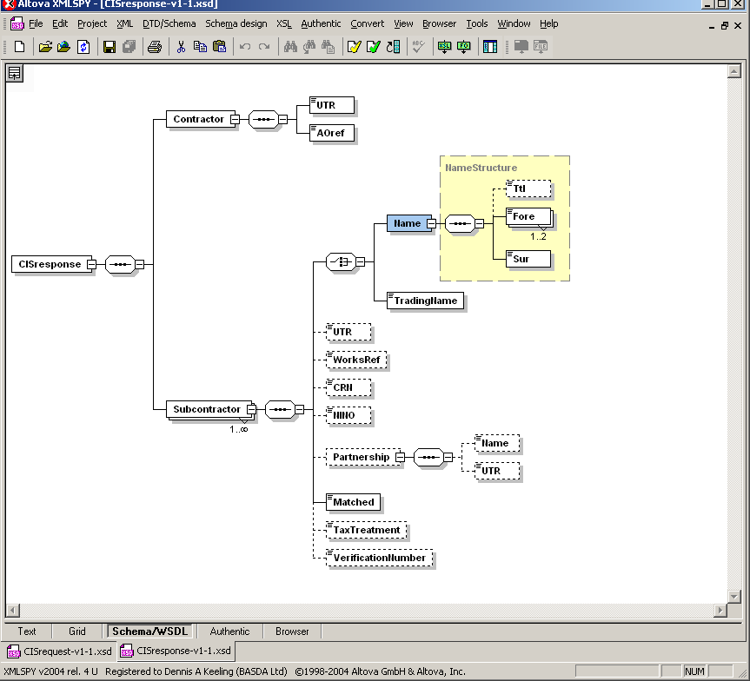

Slide 12
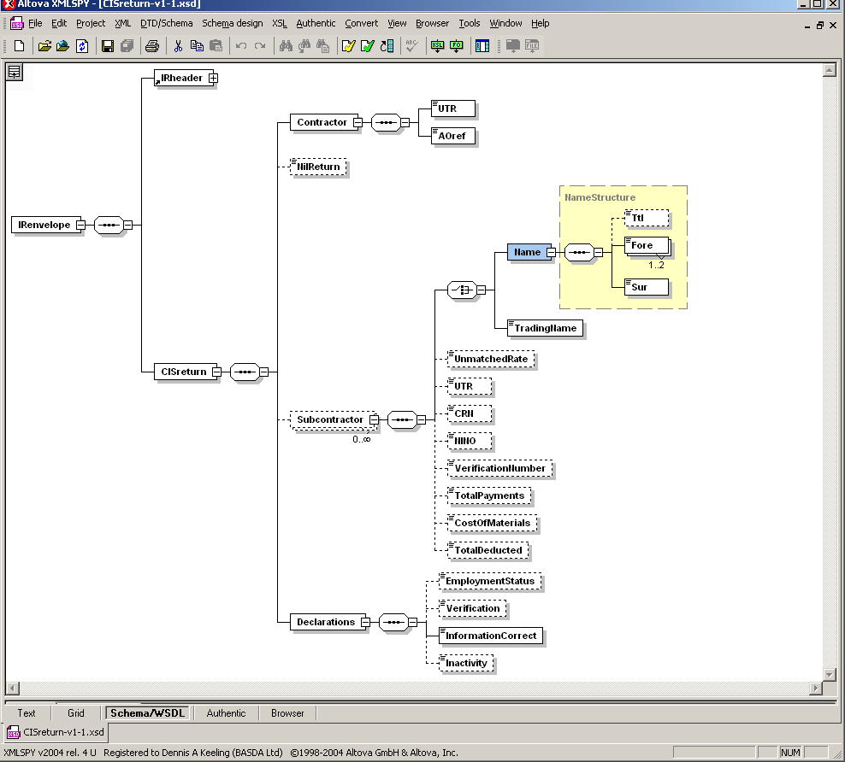

Slide 13
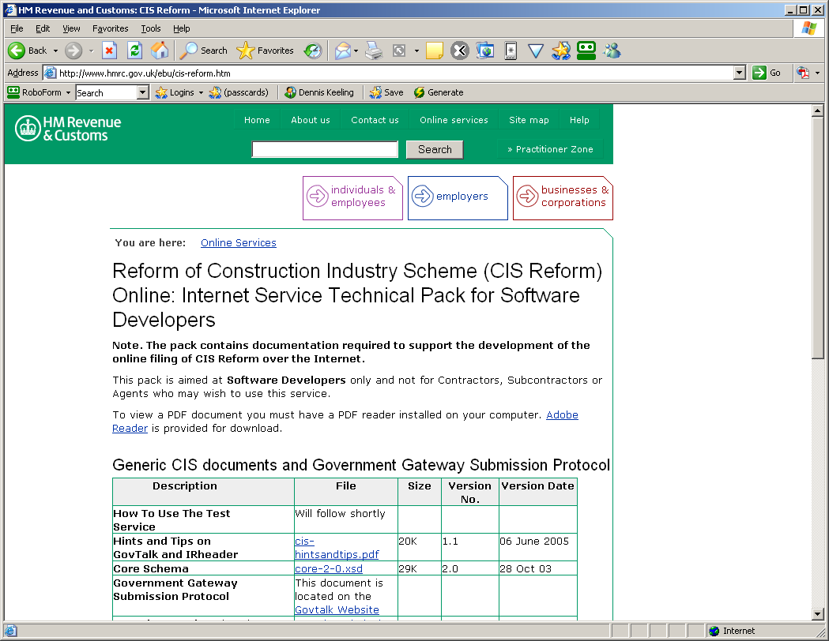

Slide 14
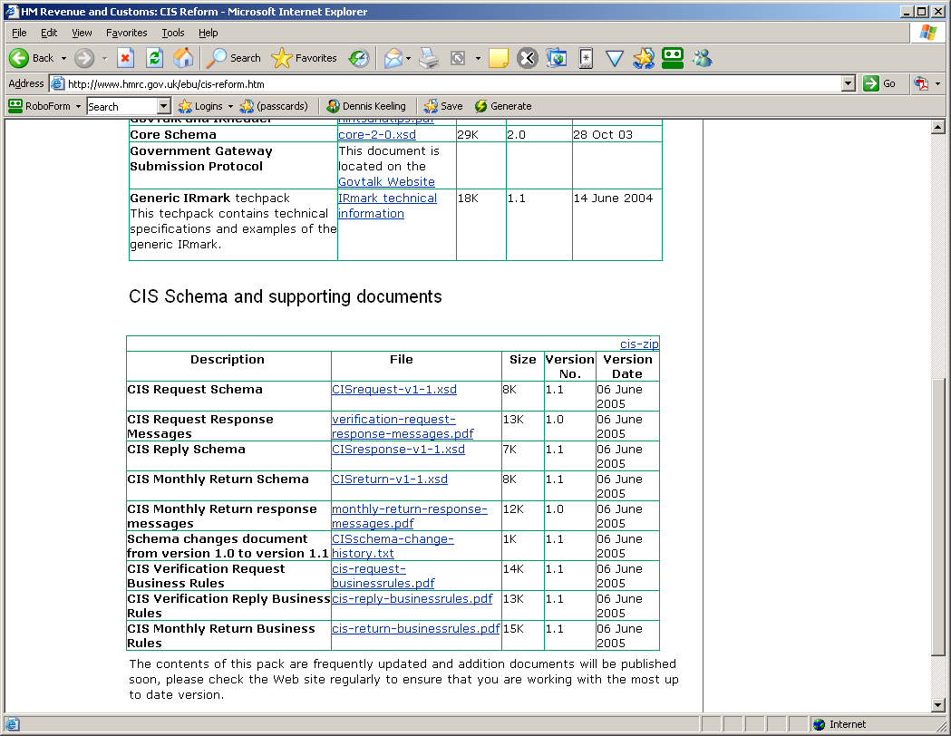

Slide 15
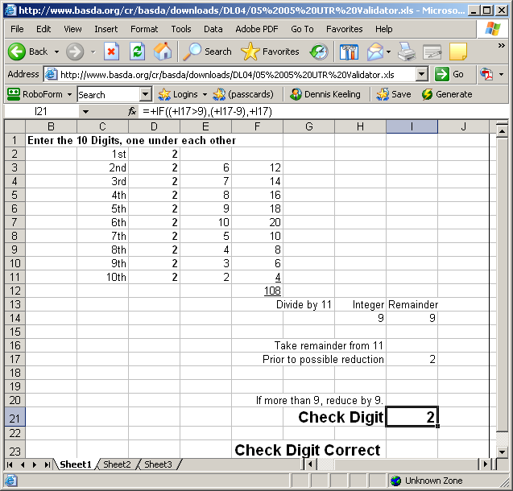

Slide 16
Information Contacts
HM R&C
  http://www.hmrc.gov.uk/ebu/cis-reform.htm
BASDA
  http://www.basda.org – Knowledgebase - CIS
  http://www.basda.org/VD04/default.asp?PSID=76

Slide 17
BASDA Contacts
BASDA - - Accounting Standards
- IFRS Seminars
- eBusiness Booklet
- XML Workshops
tel +44 (0)1494 677699
fax +44 (0)1494 681894
e-mail info@basda.org
Web http://www.basda.org

